Slide 1

Real-time operating system
Priority based Services Discipline For Switched Network
by
Ila Kaushik
Dept. of IT
KIET Group of Institutions

Slide 2
Contents
Priority based Services Discipline For Switched Network
Waited Fair Queuing (WFQ) Discipline
Weighted Fair Queuing
Scheduling algorithm
Weighted Round Robin Scheduling

Slide 3
Priority based Services Discipline For Switched Network
In Priority based Services Discipline, the transmissions of ready packets are scheduled in a priority driven manner.
Among this class of discipline the most well known are:
Weighted fair queuing
Delay Earliest due date
Jittered EDD
Rate controlled static priority

Slide 4
Waited Fair Queuing (WFQ) Discipline
The WFQ is nonpreemptive algorithm for scheduling packet transmission in switched network
It is a rate allocating service discipline
It provides each flow with at least its proportional fair share link capacity
It isolates the timing between flows
It is also called as packet by packet generalized processor sharing algorithms.

Slide 5

Cont..
The weighted fair queueing algorithm shares the processes within one packet transmission time regardless of the incoming pattern.
It is define as a packet switch with several inputs that are feeding to an output link, shared by n established flows where each flows i is allocated to ui of the link such that total bandwidth allocated to all connections is:

Slide 6
Queuing is the result of congestion on an interface,
That means the transmission ring is full and the interface is engaged in sending designated packets.
The purpose of WFQ is to share limited link bandwidth between processes and flows.
The queue size can be manipulated sometimes within the software, but that too can sometimes be of no use.
If the queue size is too small, all the data becomes congested.
Similarly, if the queue size is too large, it is never completely utilized.

Slide 7
Scheduling algorithm
When the first packet in a busy interval of the output link arrives, the scheduler computes its finish number and enters this number and connection ID in the SFN queue.
During a link busy interval, the scheduler computes the finish number of each packet that arrives on an idle connection and inserts the corresponding entry into the SFN queue.
For as long as the link is busy, whenever the transmission of a packet on the link completes, the packet is removed from the connection’s FIFO queue and the entry containing the finish number of this packet is removed from the head of the SFN queue.

Slide 8
4. The scheduler chooses the next packet to transmit in the following manner:
(i) if connection i is still backlogged, the scheduler computes the finish number of its new ready packet and inserts this number and connection ID in the SFN queue.
(ii) it then commences the transmission of the ready packet on the connection identified by the first entry in the SFN queue.

Slide 9
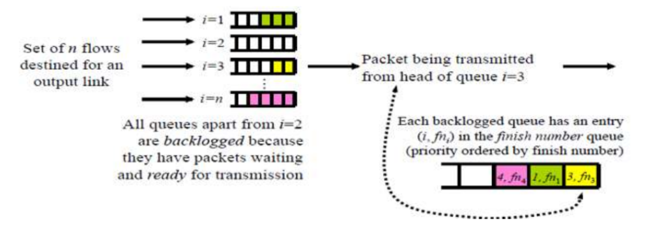
In WFQ, the output buffer comprise of two queues as FIFO and shortest finish number (SFN) for scheduling of packets.
FIFO is used to scheduled n flows whereas priority ordered SFN is used to schedule the job obtained from the head FIFO queue on the basis of finish number.
The finish number specifies the number of ready packets for transmission.
A packet becomes ready on FIFO queue, a finish number is calculated and SFN queue updated.
The newly arrived packet is placed on the head of SFN queue without preempting the current transmission.
When packet completes its transmission then it is removed from head of SFN and FIFO queue.

Slide 10
Weighted Round-Robin Service Disciplines for Switched Networks
Messages in a switched network are pipelined through the switches.
Earlier packets in a message are sent from a switch without having to wait for the arrivals of later packets.
For scheduling message transmissions through switches and for pipelined jobs in general, the WRR scheme offers an excellent alternative to time driven and priority driven schemes.

Slide 11
It is better than time driven scheme when used for end to end scheduling in a network or distributed system because it does not require globally synchronized clocks.
It is better than priority driven scheme because it does not require any sorted queue.
Due to above advantages, WRR is a good practical choice for constant bit rate traffic such as uncompressed voice.

Slide 12
WRR Scheduling
In round robin scheduling, jobs are placed in a FIFO queue
Job at the head of the queue executes for one time slice
If it doesn’t complete within the time slice, it is pre-empted and put at the back of the queue
There are n jobs in the queue, each job gets one slice every n time slots (that is, every round)
A weighted round robin schedule extends this, to give each job i a weight wti
A job with weight wti executes for wti time slices each round
Length of the round equals wti
i=1 i=2 i=3
Copyright © 2006 University of Glasgow All rights reserved.
Set of n flows destined for an output link
wt_{i} packets from queue i sent in turn
…
i=n

Slide 13
Following variants of the WRR scheme has been proposed for scheduling message transmission in packet switched network:
Greedy WRR Discipline
Stop and Go algorithm
Hierarchical Round Robin algorithm
Budgeted WRR Algorithm

Slide 14
Thank You

